Slide 1


Ultralight Turbine-less Jet Engine Research:
Conceptual and Experimental Studies of Alternative Propulsion Systems for Next Generation UAV’s
Embry-Riddle Aeronautical University – NASA Space Grant
Student Researcher:
Tre Buchanan
Junior, Expected Graduation: May 2017 Mechanical Engineering-Propulsion Major
Faculty Research Mentors:
Shigeo Hayashibara, Ph.D., Associate Professor of Aerospace Engineering (Aerodynamics / CFD)
Prior Conceptual Research: Tyler Eiguren, AE Aero, May 2016
Current Conceptual & Experimental: Stephen Woodard, AE Aero, May 2017
& Isaac Anderson, AE Aero, December 2016

Slide 2

Overview
Project Concept
Design Iteration 1.0
  Fabrication
  Experimental Data Acquisition
Design Iteration 2.0
  Design Modification Process
  Challenges/Setbacks
  Current Design Progress
Projected Timeline - Conclusions

Slide 3
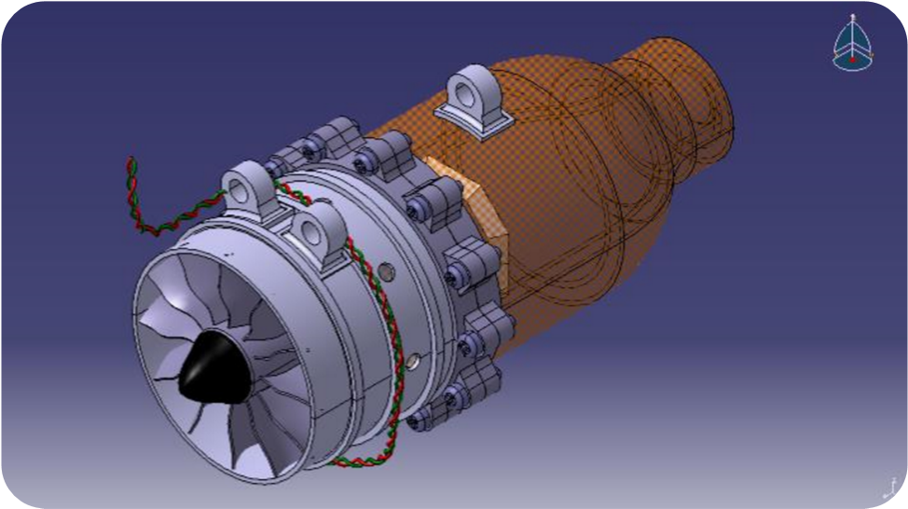
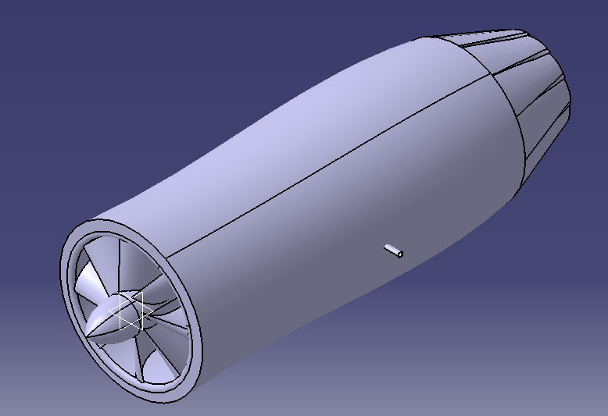
Project Concept
We aim for a simplified, cost effective propulsion device:
  Electrically Ducted Fan (EDF)
  Duct burner aft of fan for combustion containment
  Fuel (C4H10 Butane)
  Flame holder for constant burn in circulation zone
  Nozzled for thrust optimization
  Dual thrust production capabilities:
    Combustion – take off, ascent, as needed
    EDF only – cruising, noise/fuel reduction & battery regen

Slide 4
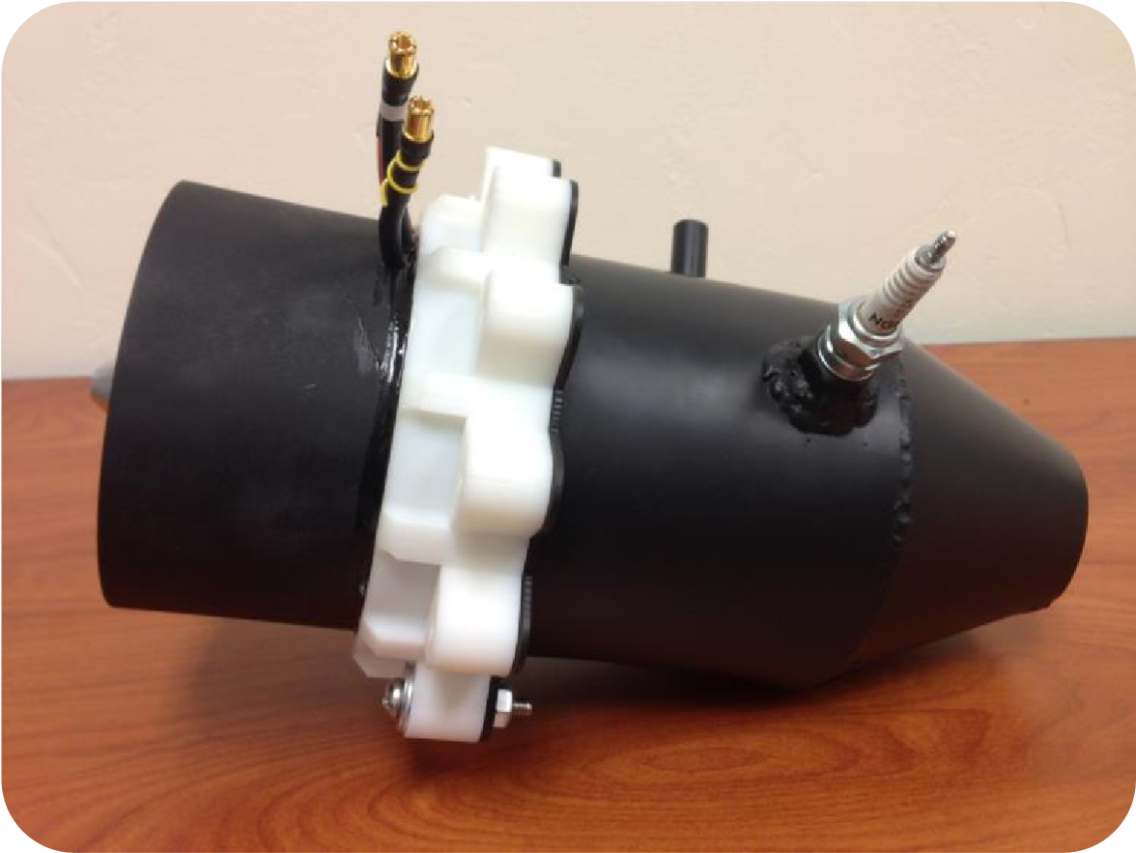
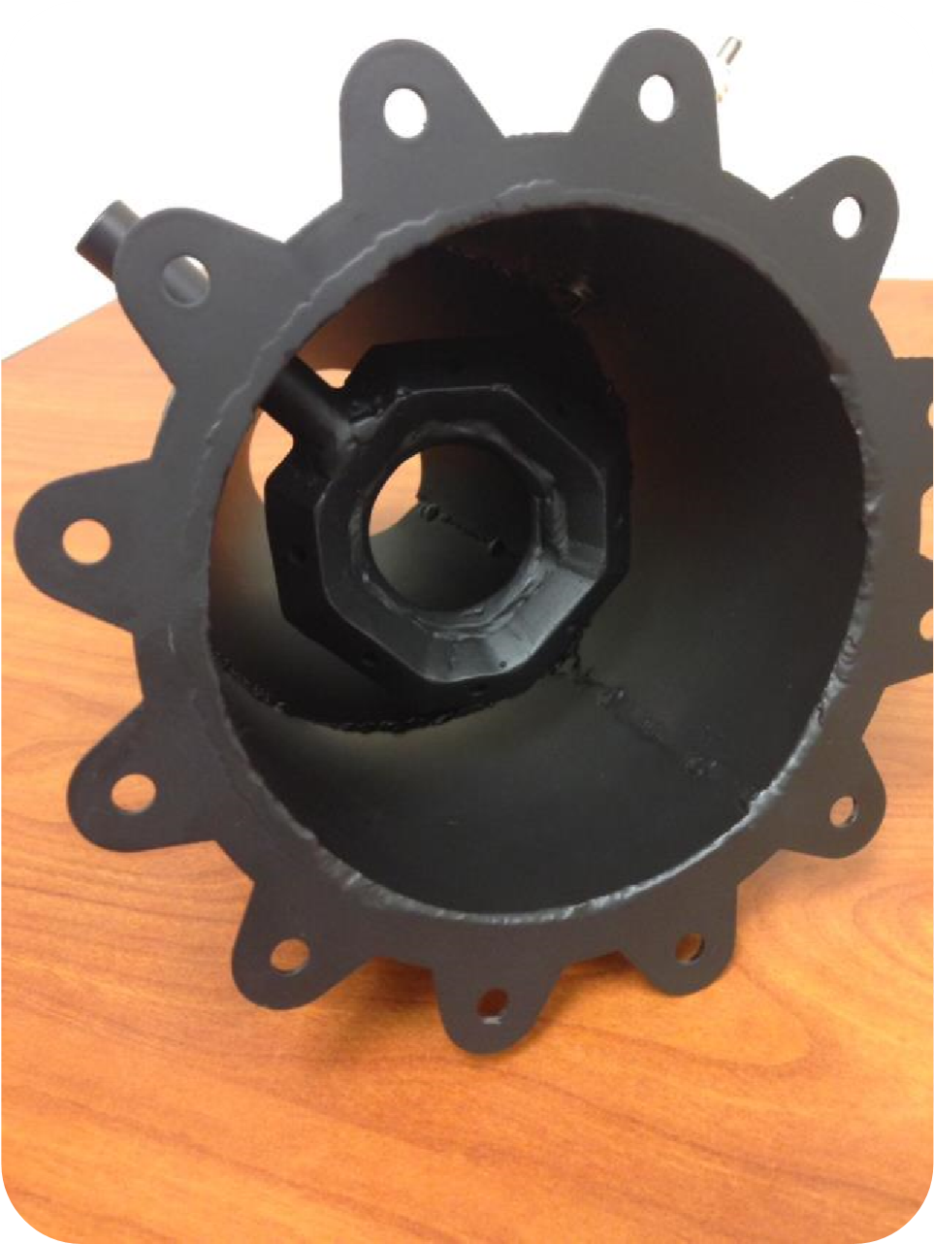
Fabricated Product
Carbon-Fiber, 11 Blade Fan (94 N, 24 lbf thrust)
HET Typhoon Brushless Motor(14 cell, 127.8A)
ESC Controller, 160 Amp for 10,000 mAh
Burner can welded at ERAU (Ryan Bishop)
Cerakoted by Affordable Powdercoat Phoenix
Nozzle contour modified, but overall dimensions retained
Motor Mount – 3D Printed at ERAU
Ignition – Grill igniter

Slide 5
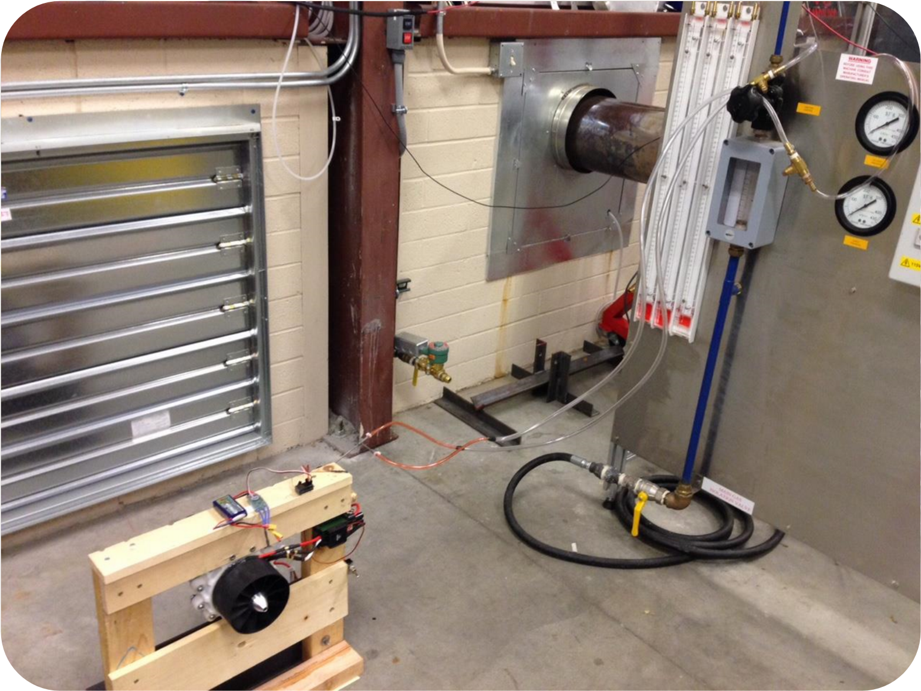
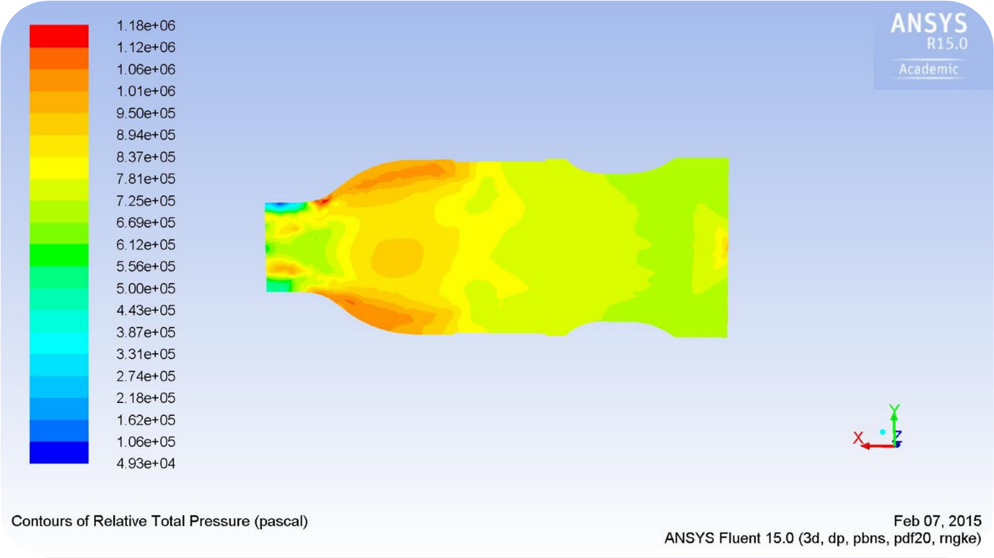
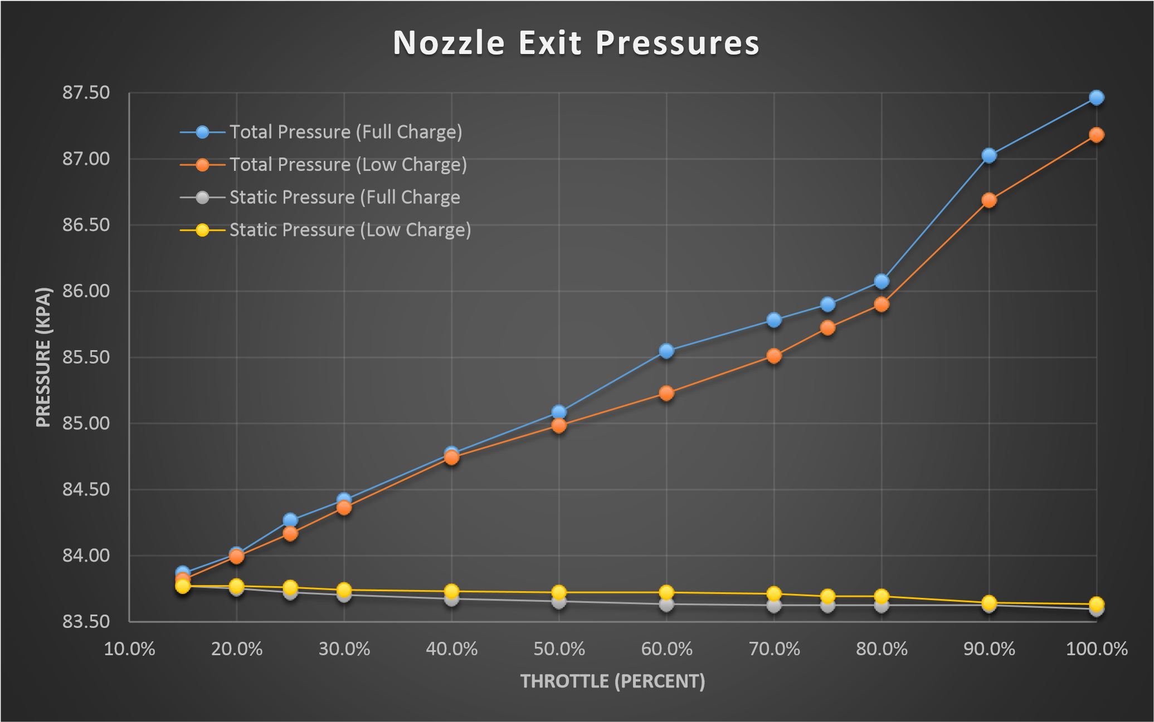
Experimental Data Acquisition
CFD Analysis conducted by Tyler Eiguren

Slide 6

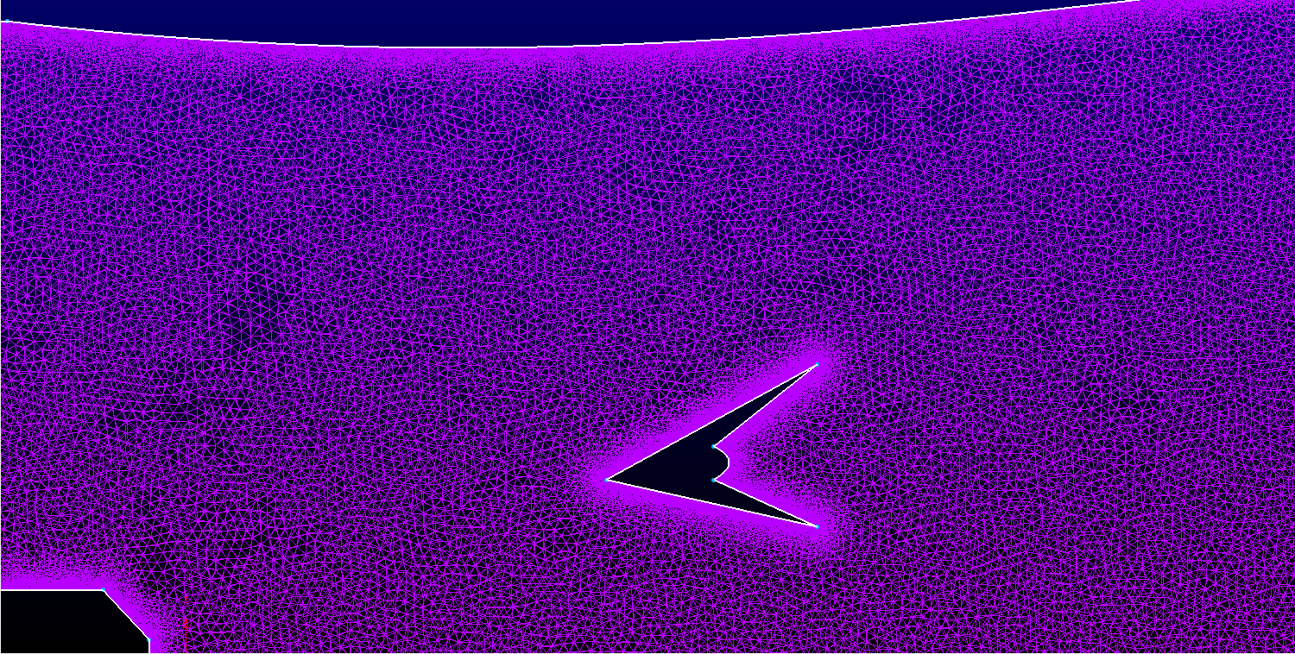
Design 2.0 Modification Process
Software utilized:
  ANSYS Fluent 15.0 (Preprocess, Solver, PostProcess) *Iteration 1.0
  Pointwise (Preprocessor) *Iteration 2.0 – First Trials
  SC-Tetra-Cradle (Preprocessor & Solver) *
  Fieldview (Post-processing) *Current progress
Simulations conducted:
  Steady state, through flow analysis
  Non-combustion modelling for static test comparisons
  Boundary conditions:
    Rotating fan inlet (75000 RPM)
    ABS Plastic Wall Properties (0.08 Coeff. of Friction)

Slide 7
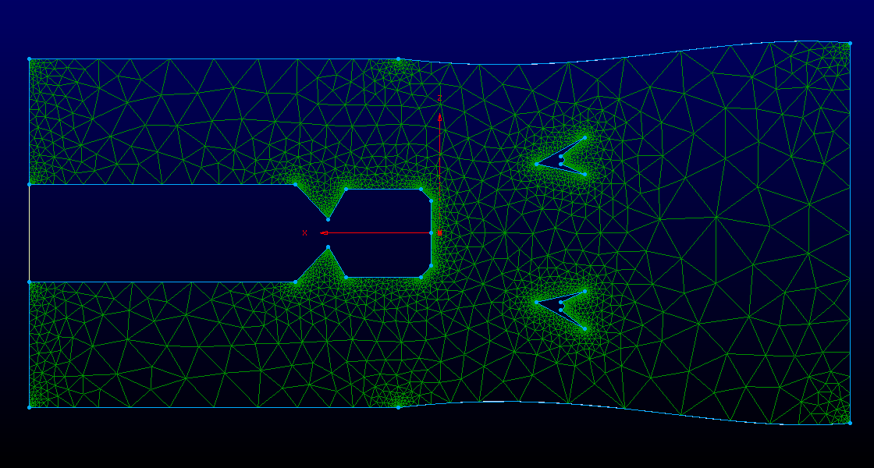
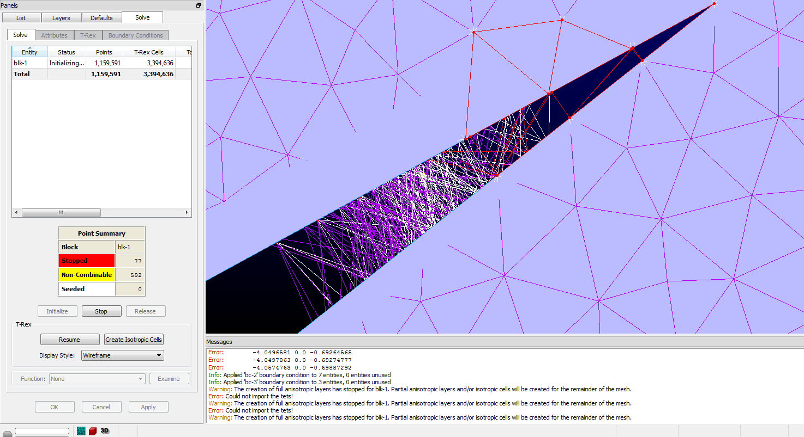
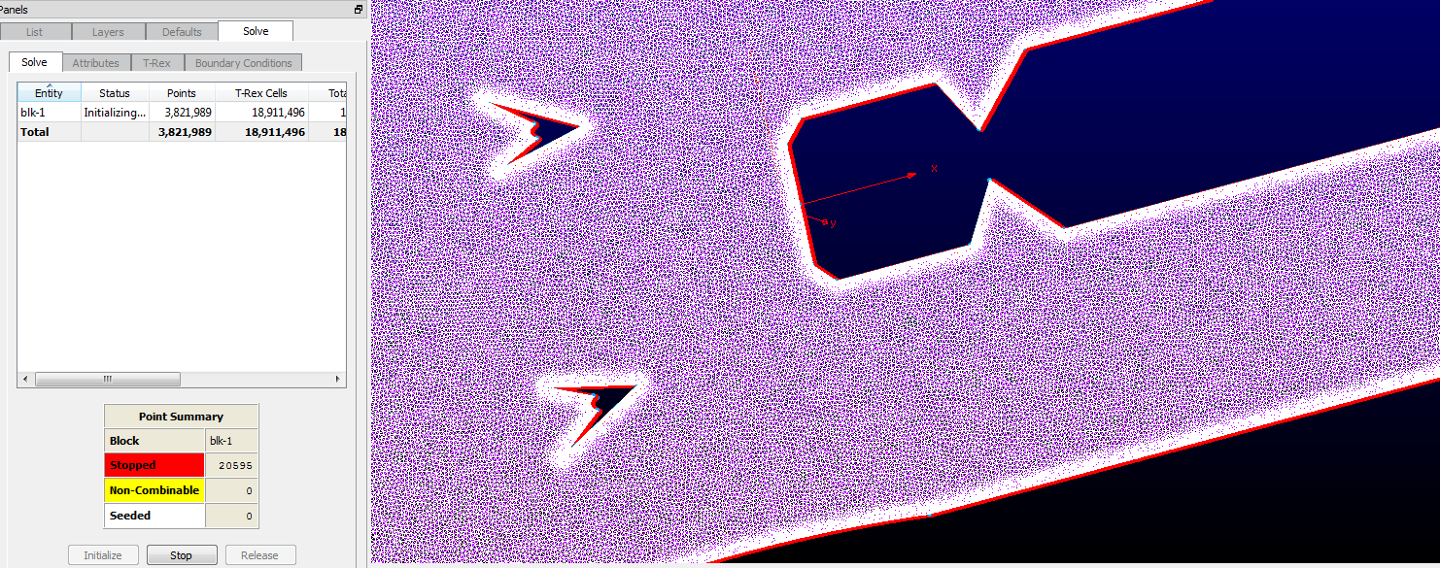
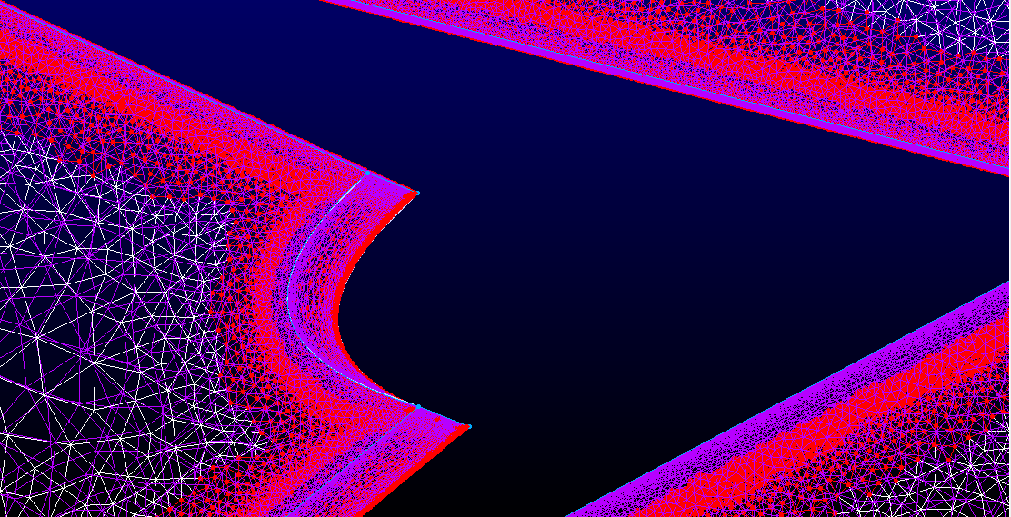
Challenges/Setbacks

Slide 8
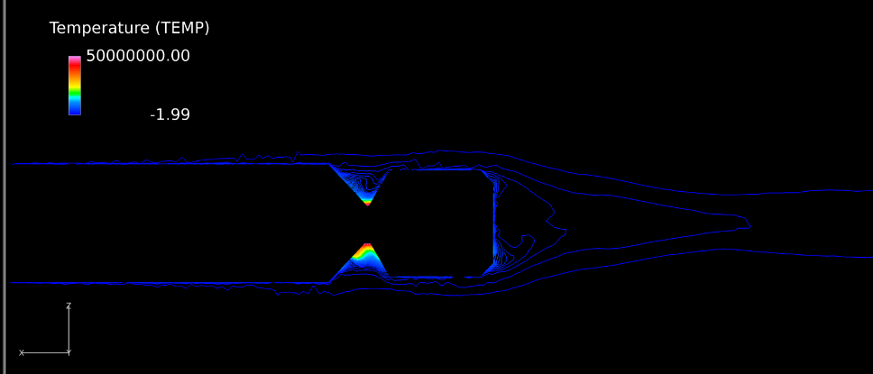
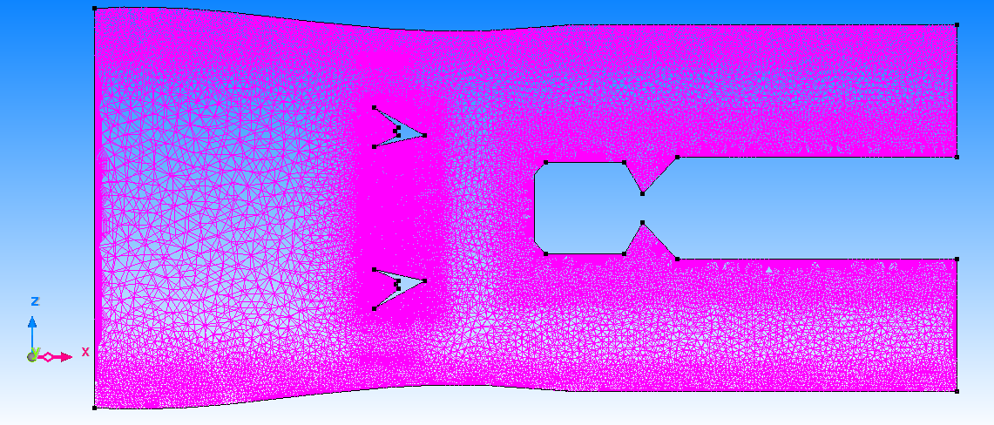
Current Design Progress
Inner Wall Contours Optimized
Nozzle Simulations Conducted By Research Partner Stephen Woodard
Mesh Properties:
  91,295 Nodes
  295,161 elements

Slide 9
Current Design Progress (Cont.)

Slide 10
Current Design Progress (Cont.)

Slide 11
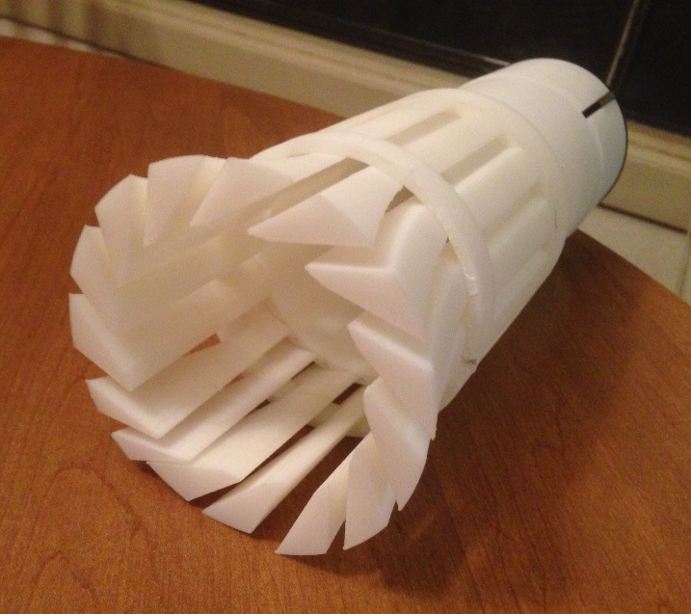
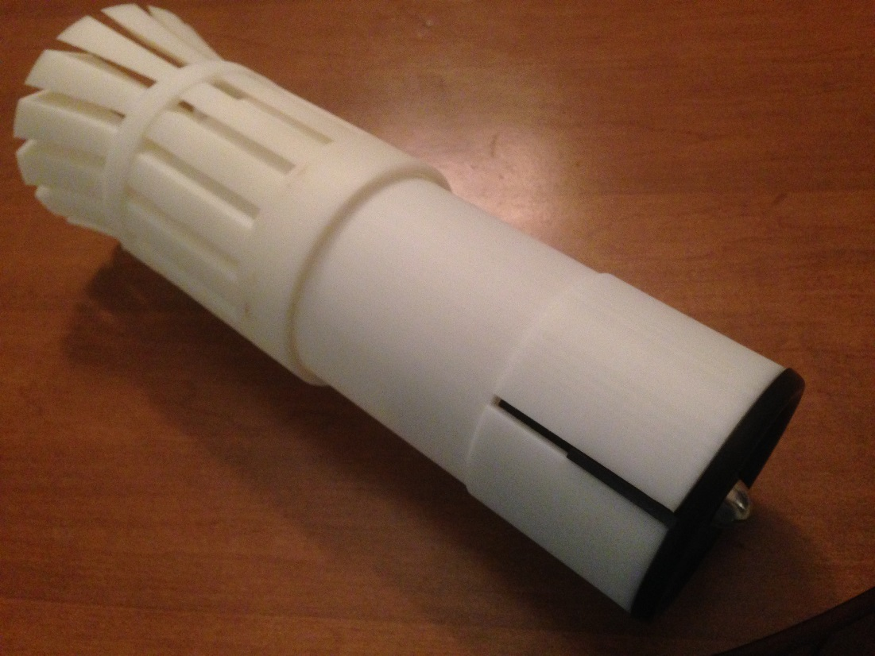
Projected Timeline - Conclusions
Engine Currently Assembled
Static experimental testing for simulation validation (April ‘16)
Combustion testing & simulation modelling (Summer/Fall ‘16)
Wind Tunnel testing (static) (Summer/Fall ‘16)
Iteration 3.0 for Senior Design Project- ME Propulsion (Fall ‘16/Spring ‘17)
  Pair with Aero Senior Design Team for Platform development

Slide 12
Ultralight Turbine-less Jet Engine Research:
Conceptual and Experimental Studies of Alternative Propulsion Systems for Next Generation UAV’s
Embry-Riddle Aeronautical University – NASA Space Grant
Student Researcher:
Tre Buchanan
Junior, Expected Graduation: May 2017 Mechanical Engineering-Propulsion Major
Faculty Research Mentors:
Shigeo Hayashibara, Ph.D., Associate Professor of Aerospace Engineering (Aerodynamics / CFD)
Prior Conceptual Research: Tyler Eiguren, AE Aero, May 2016
Current Conceptual & Experimental: Stephen Woodard, AE Aero, May 2017
& Isaac Anderson, AE Aero, December 2016

